Slide 1

From Feasibility to Final Product: Delivering Success for an Inhaled Development Programme
View as Slide Show for Audio
Sandy Munro, Nikki Willis, Geraldine Venthoye
Respiratory Drug Delivery Congress, April 2020

Slide 2
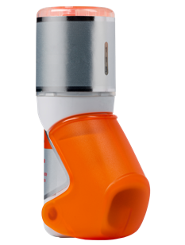
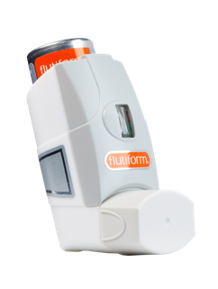
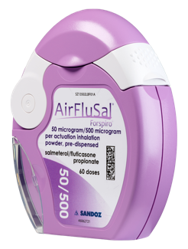
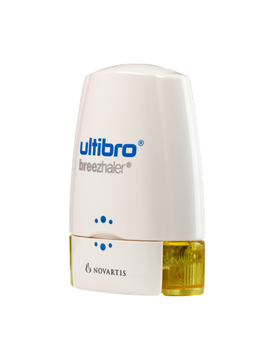
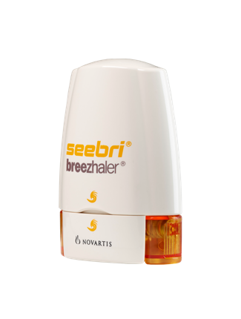
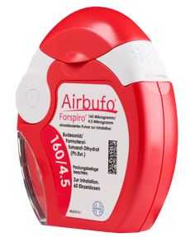
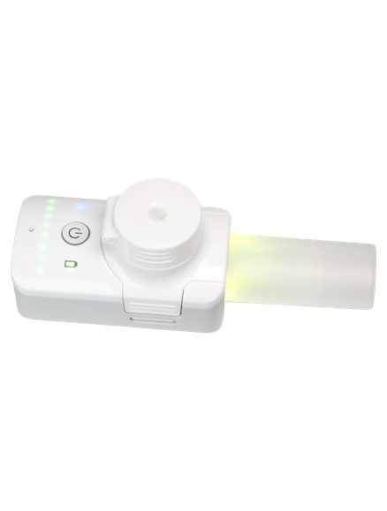
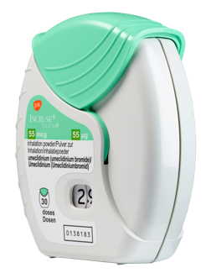
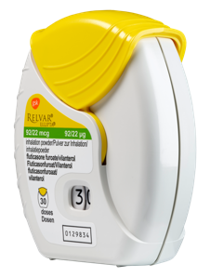
Helping our customers succeed in bringing inhaled medicines to market
Airbufo®, AirFluSal®, Forspiro®, Ulitbo®, Seebri® and Breezhaler® are registered trade marks of Novartis AG. flutiform® is a registered trade mark of Jagotec AG (in some territories, owned by Mundipharma AG). K-haler® is a registered trade mark of Mundipharma. Relvar®, Incruse® and Ellipta® are registered trade marks of Glaxo Group Ltd. GSK products shown – technology license from Vectura.

Slide 3
Vectura offers fully-integrated services to support customers in the development of inhaled medicines
FORMULATION SCIENCE
DEVICE TECHNOLOGY
DEVELOPMENT EXPERTISE
Small molecules & biologics
DPI
pMDI
Smart Nebuliser
Product manufacturing
Comprehensive
analytics
Process development & scale-up
Medical & regulatory
Pre-clinical development
Phase I
Phase II
Phase III
Regulatory
approval
Commercialisation

Slide 4
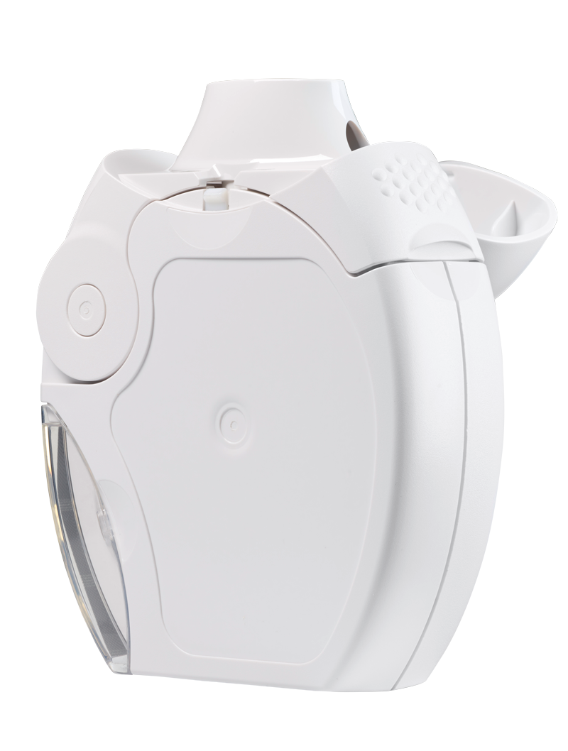
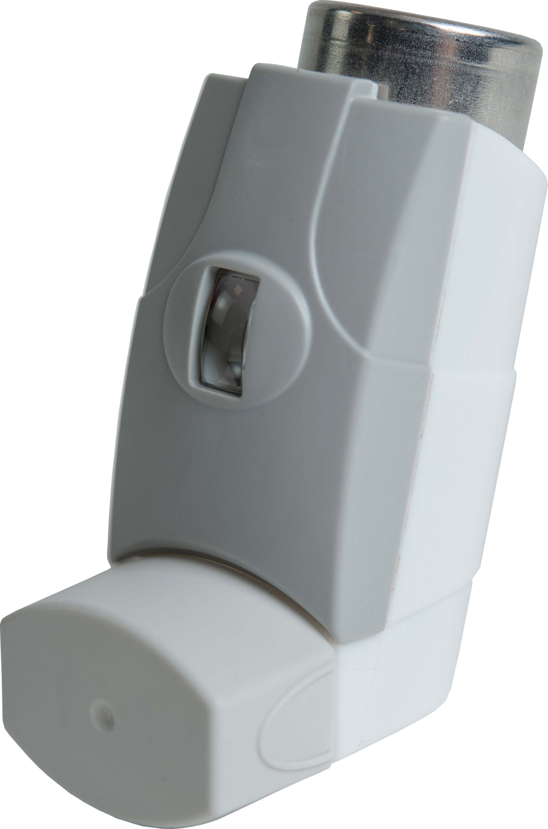
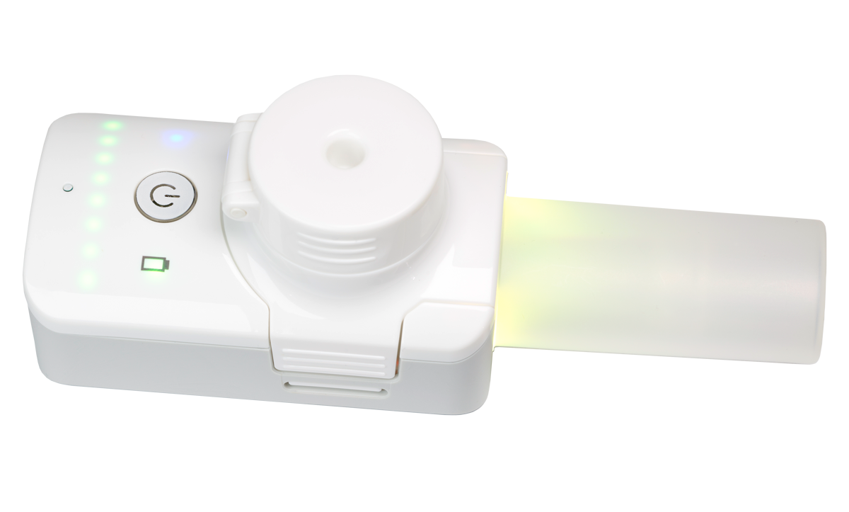
From Feasibility to Final Product: Delivering Success for an Inhaled Development Programme
Aim to answer the following key questions
  How can I maximise the chance of success for an inhaled programme?
  How can I accelerate development timelines and reduce costs?
  How can I minimise the risk associated with the process scale-up?
  How can I deliver growth and continuous improvement after launch?
Case Studies
1
2
3
  Smart nebulisation for a cost-effective, fast-to-clinic development
  Managing DPI scale-up and industrialisation
  Successfully growing volume and continuous improvement of a commercial pMDI

Slide 5
How to select the most appropriate delivery platform technology?
Sandy Munro, Vice President - Pharmaceutical Development

Slide 6
Many factors influence delivery platform selection
Development Stage
Time & Cost
Technical
Environment
(Commercial, Regulatory)
Patient Characteristics
Disease State

Slide 7
Making informed choices can save time, money and maximise the probability of success at a given stage of development
Platform technology objectives may vary through development
Pre-clinical development
Phase I
Phase II
Phase III
Regulatory
approval
Commercialisation
Speed & cost
Target engagement & efficacy
Commercial-ready platform
Lifecycle management
Dosing flexibility
Scalability
Continuous improvement
  Potential for complexity
  Not necessarily one platform choice for the duration of a programme
  Careful management can provide opportunities to optimise development, save time & money and avoid delays

Slide 8
Smart nebulisation for a cost effective, fast-to-clinic development

Slide 9
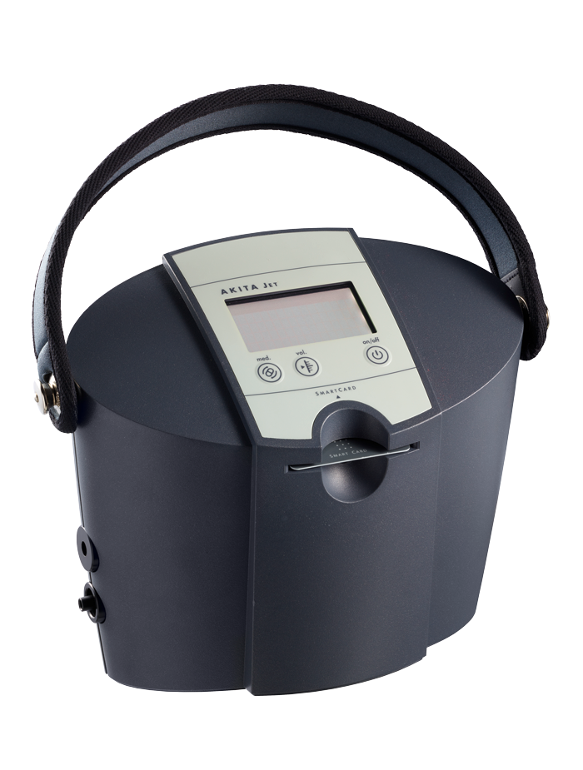
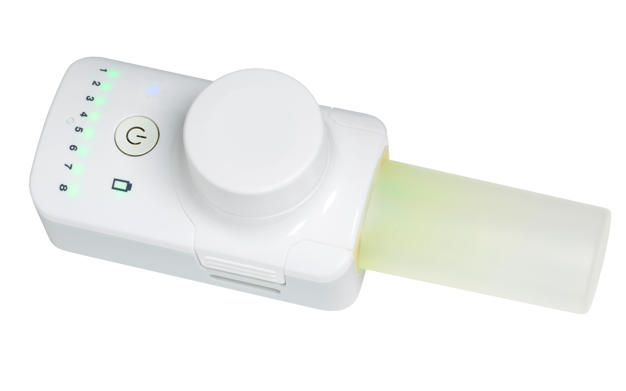
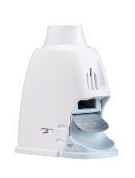
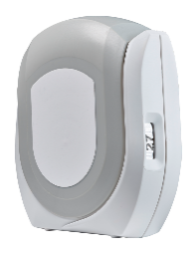
How to accelerate an early programme to the clinic?
Small molecule, rare disease development programme
Early phase.
Speed to clinic important
Multiple platforms possible
High and deep lung deposition to maximise PoS
High Dose
High water solubility
Minimise API consumption
At-home, ambulatory patient
Key influencing factors

Slide 10
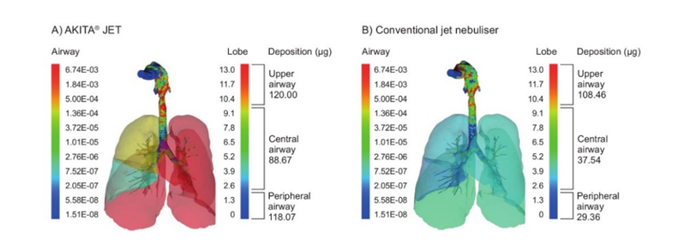
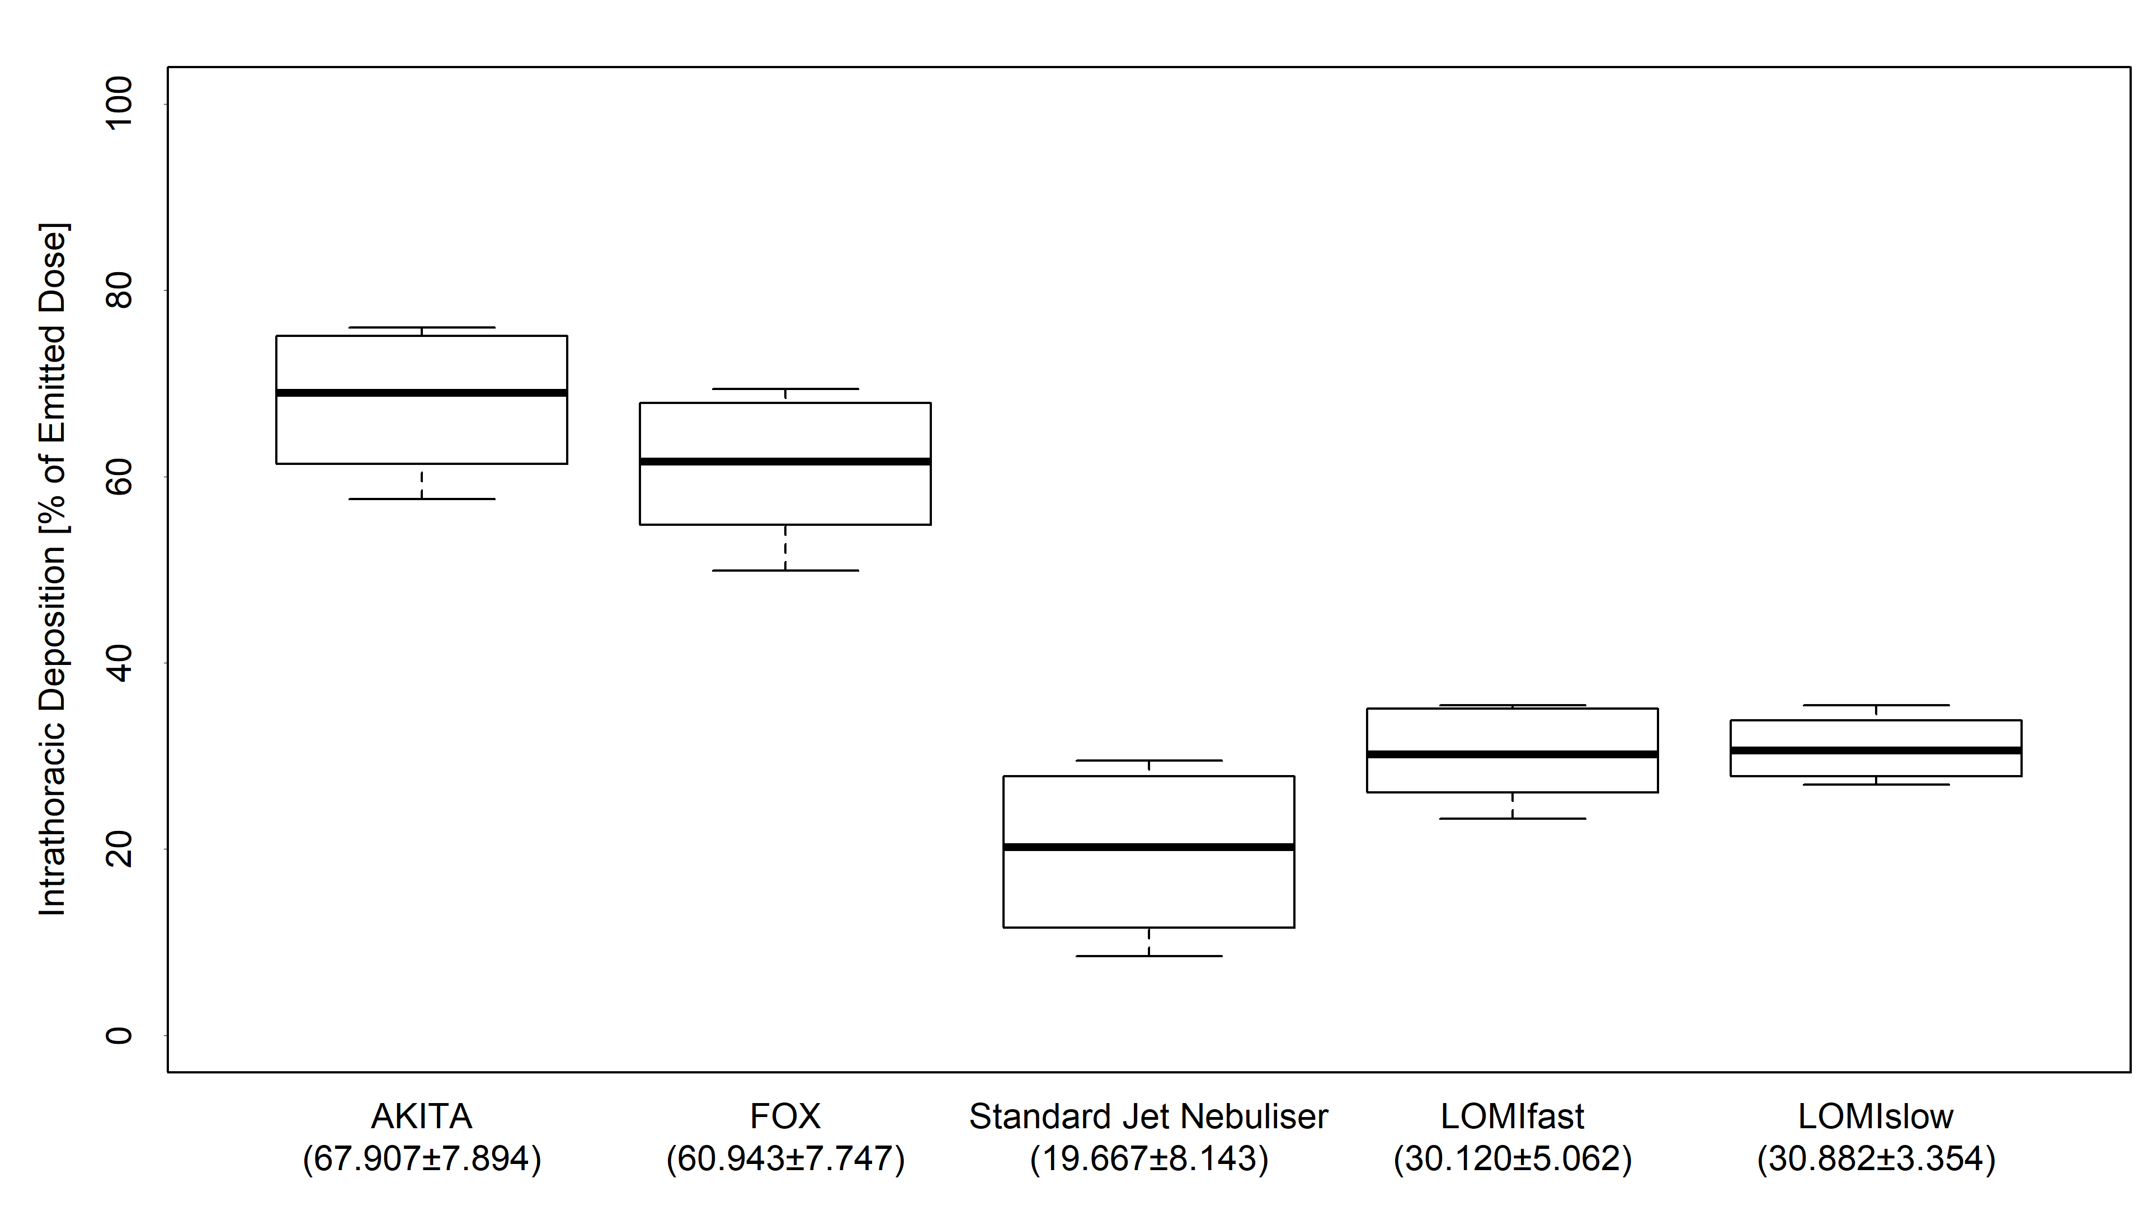
Advantages of Smart Nebulisation and FOX® Specifically
AKITA® JET
CONVENTIONAL JET NEBULISER
High and deep lung deposition with AKITA® smart jet nebuliser
FOX® Advantages
Minimal formulation development
(Soluble Molecules)
Consistent delivery
Material sparing
Low device retention
High lung deposition with slow flowrate and synchronised release
Interaction between flow rate and particle size changes

Slide 11
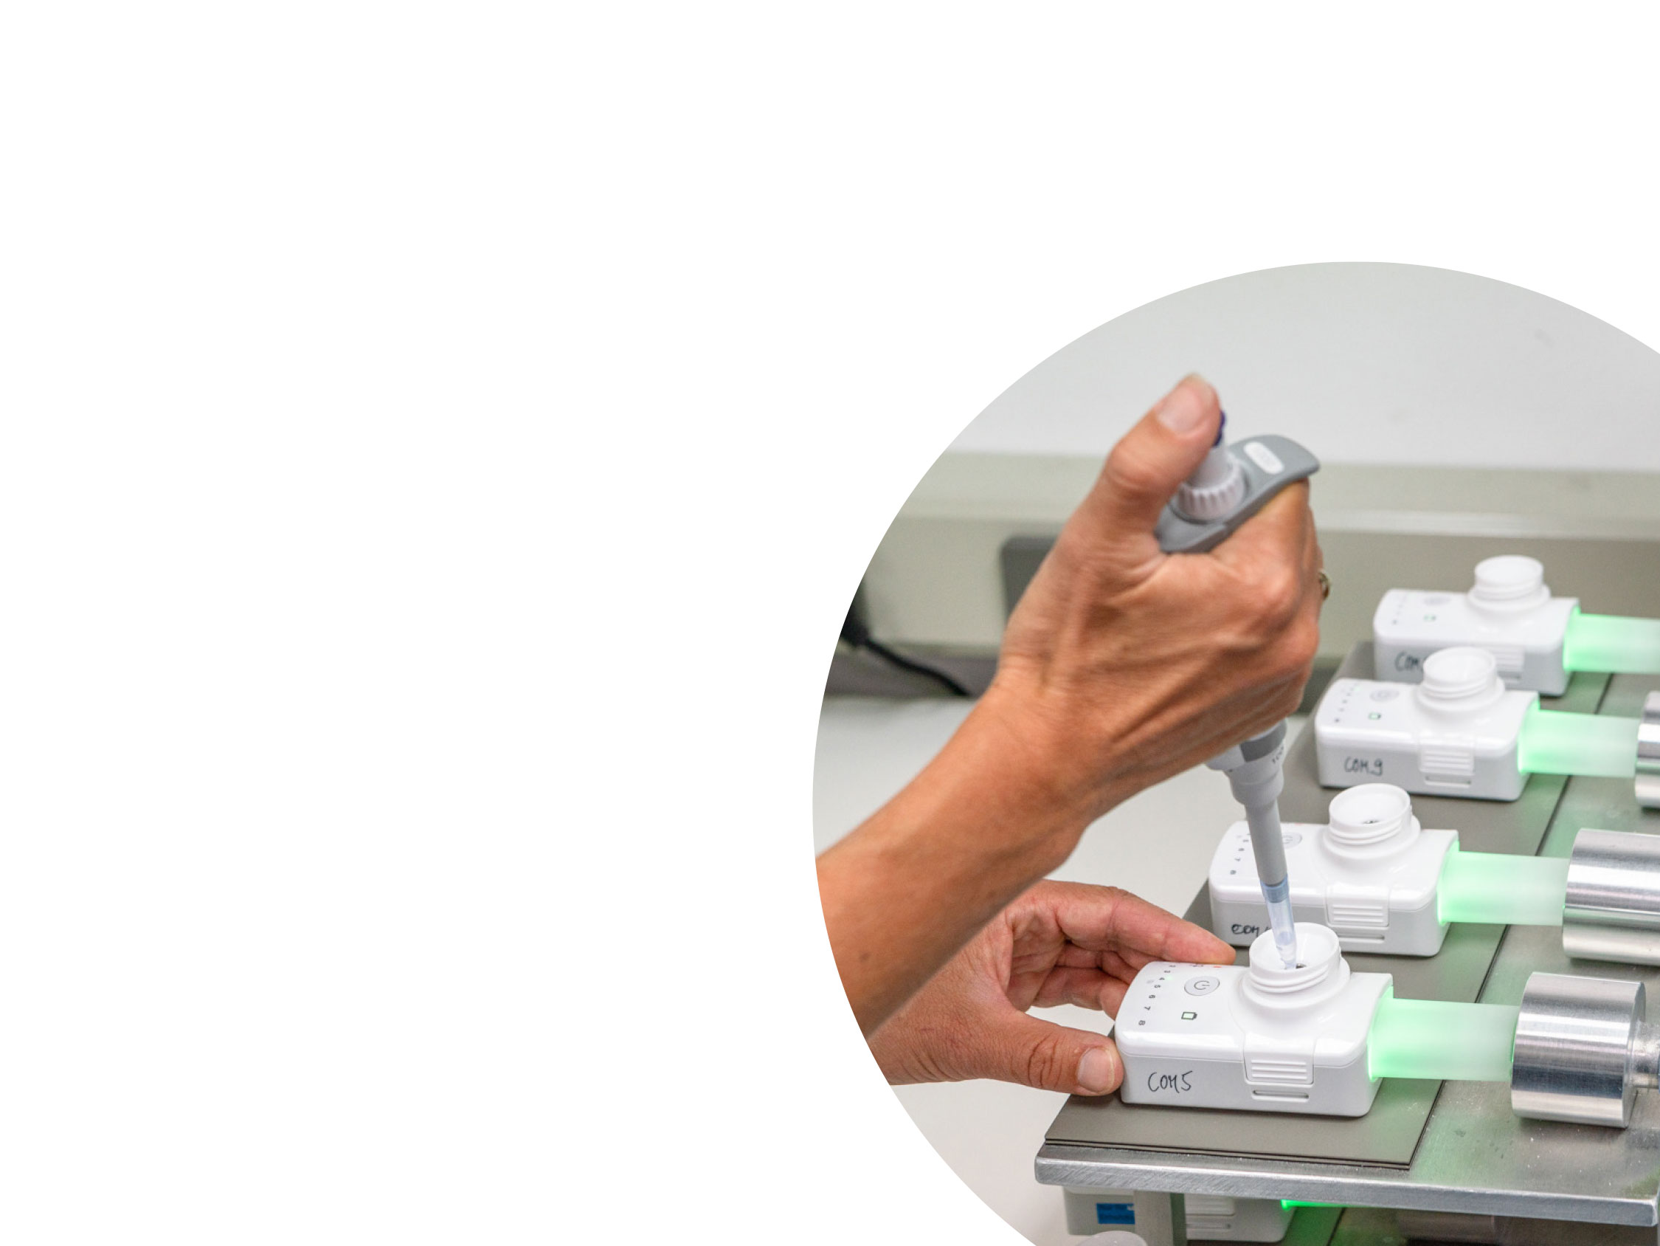
Smart nebulisation offers many advantages to accelerate and de-risk an early-stage development
A comprehensive review of factors is required to select the most appropriate delivery platform technology
Consider smart nebulisation for:
  High lung deposition to maximise probability of success
  Less complex formulation development
  Consistent delivery
  API sparing

Slide 12
Dry powder inhaler scale-up and industrialisation
Nikki Willis, Vice President – Pharmaceutical Development

Slide 13
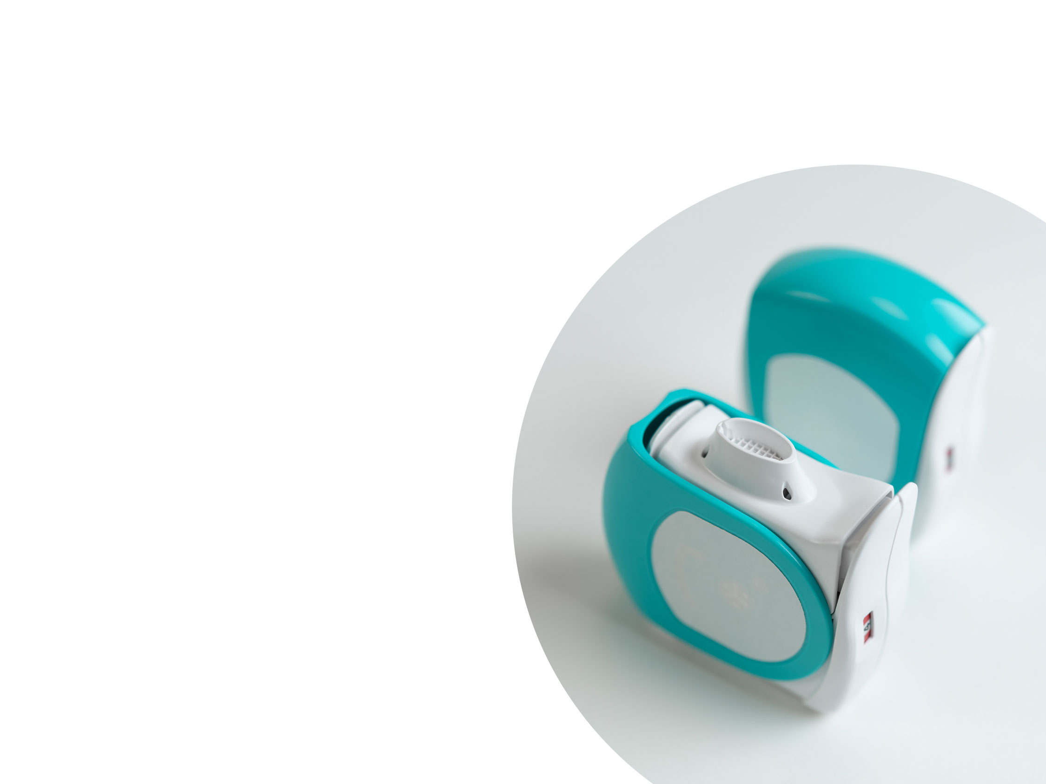
Building scalability into a development programme is essential for success
How can I be assured that the delivery platform selected is fit-for-purpose?
  From a design and manufacturing perspective
  From a patient use perspective
How can I minimise material requirements and costs in development?
How can I minimise the risk
associated with the scale up of manufacturing processes?

Slide 14
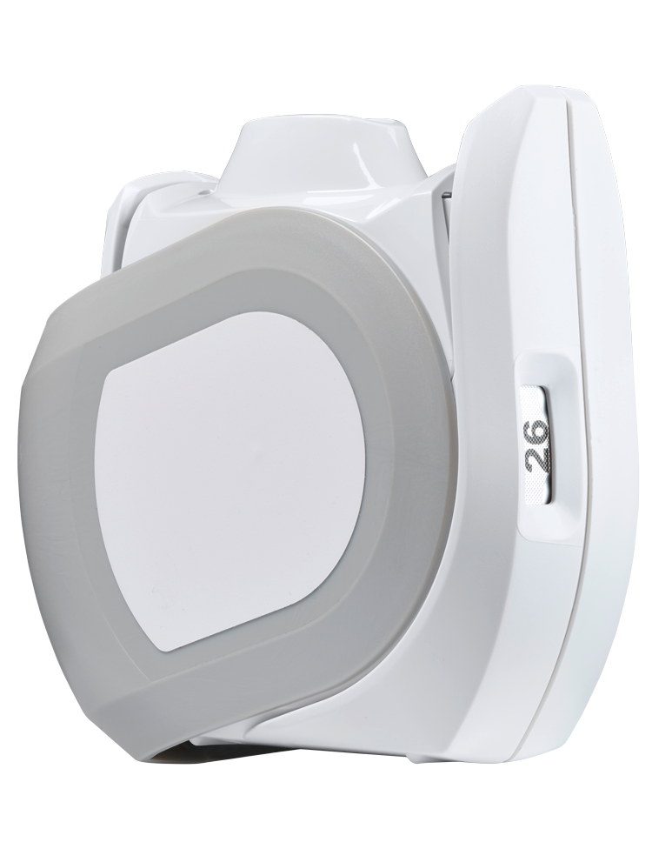
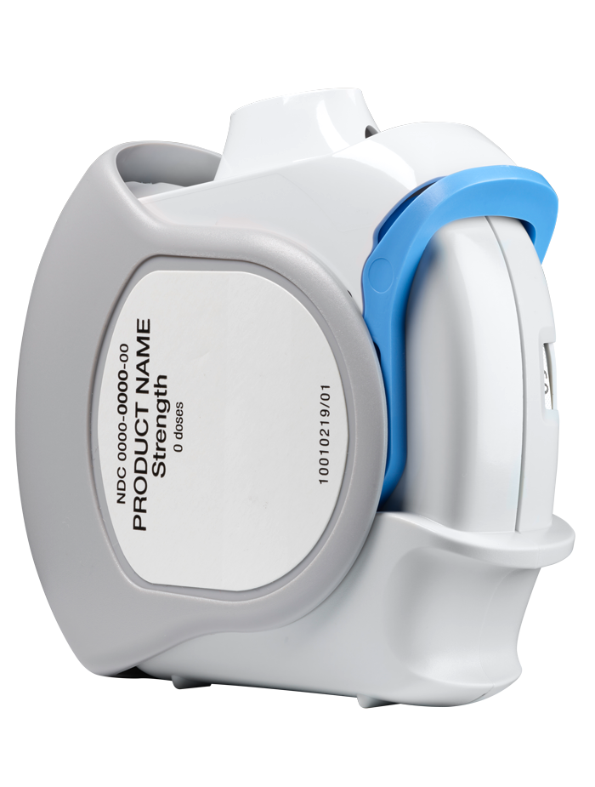
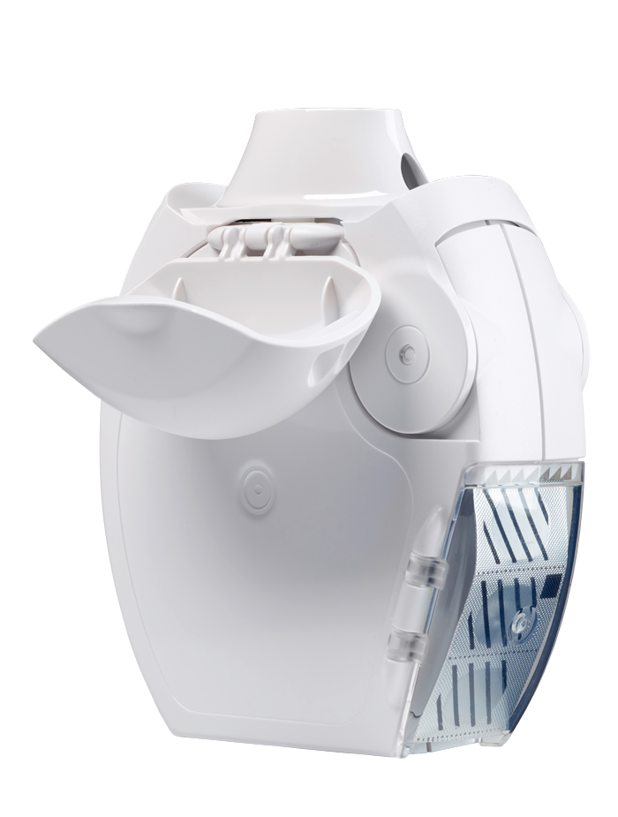
Select a device with proven delivery principles to reduce risk
Open-Inhale-Close
Lever-Operated Multidose Inhaler
GyroHaler®

Slide 15
Considering scalability early gives you confidence to develop at pilot scale to realise efficiencies and minimise costs
Increased speed/
efficiency
Reduced API costs
Reduced facility costs
Increased product knowledge
Next Generation Impactor (NGI)
Delivered Dose
Pilot scale, 0.5kg batches - made by Vectura
30kg batches - made by customer
Source: Vectura data on file

Slide 16
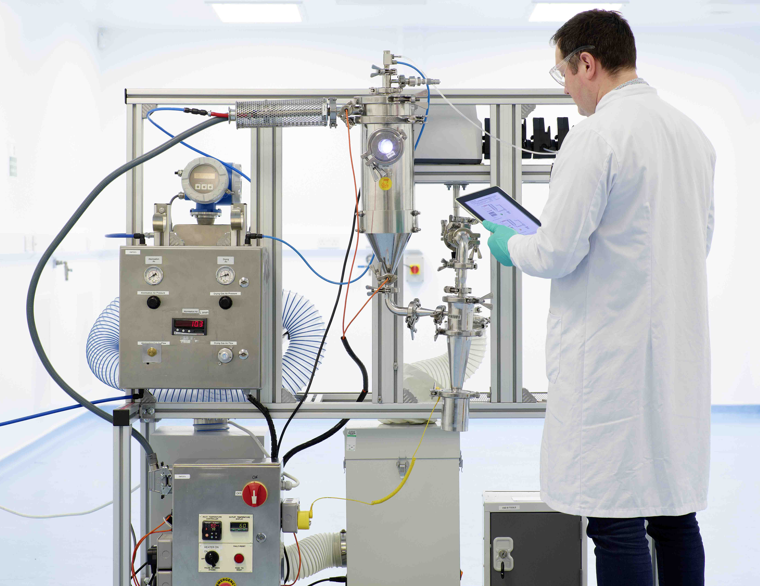
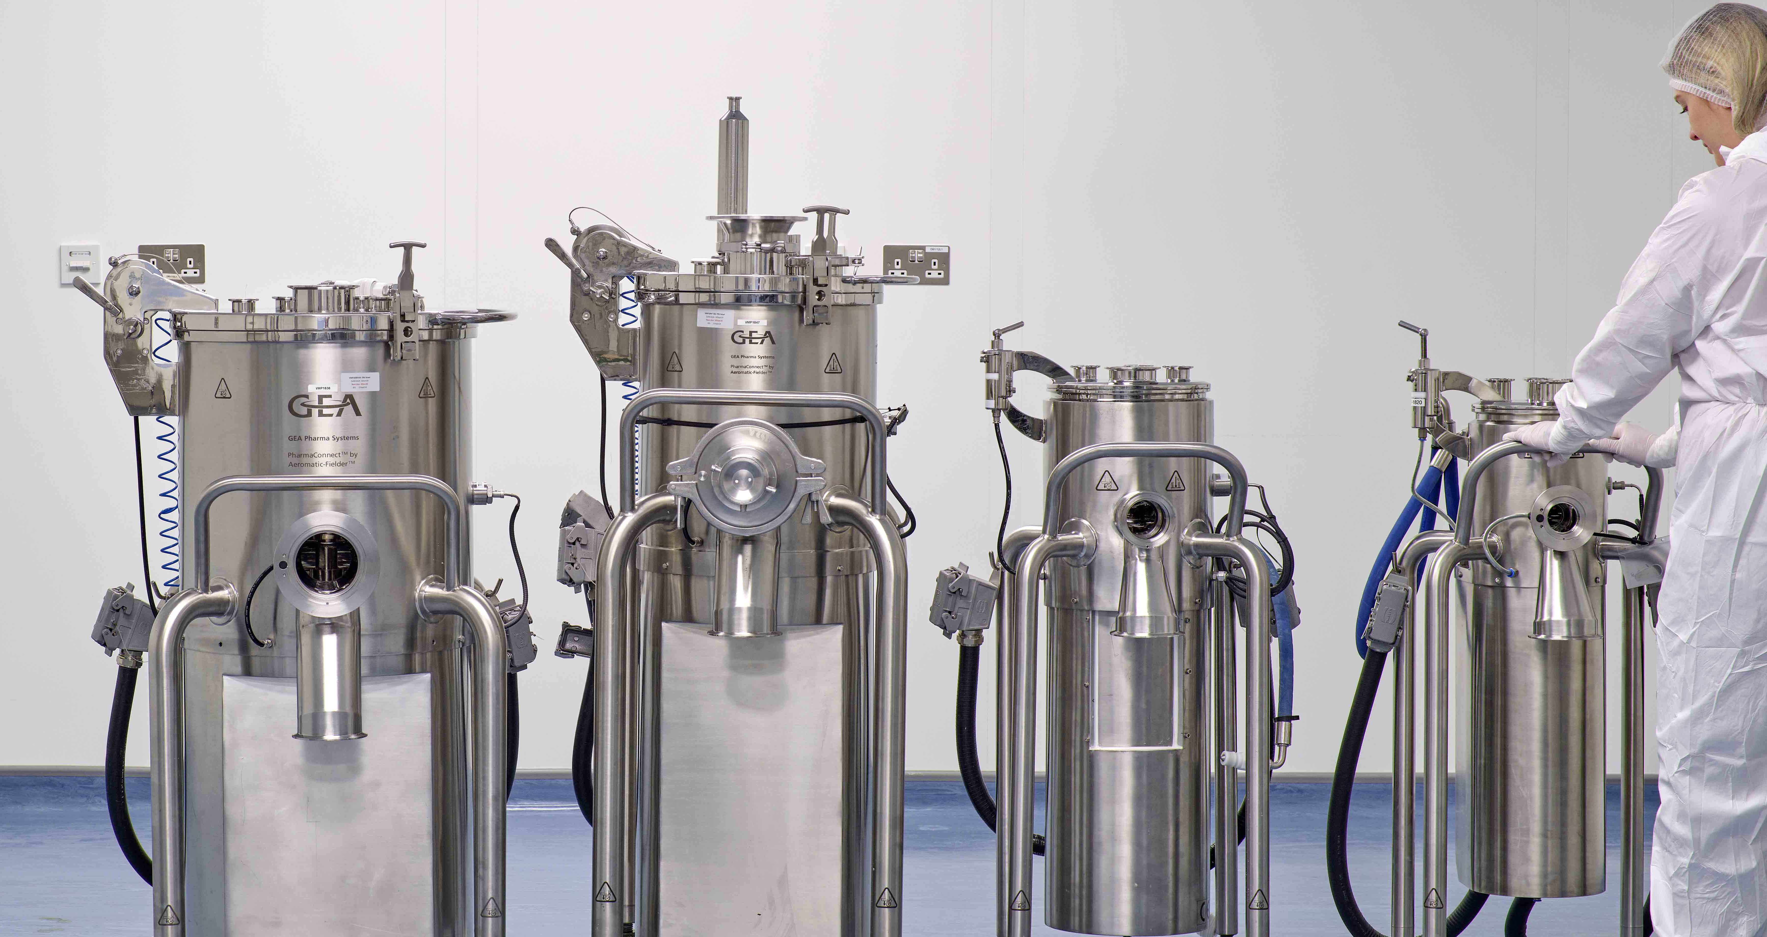
Consolidate manufacturing equipment from lab-scale to commercially-representative scale
Notes:
Consolidate manufacturing equipment– start to end of manufacturing process, lab scale to commercially representative scale
Wide range of equipment lets us move from lab scale to commercially representative scale in development phase
High degree of confidence ahead of moving to commercial manufacturing site
Intensification vs scale up – same/ equivalent unit operations
Particle engineering Mixing Filling Assembly
VSD to Niro 1L-30L TRV Omnidose to BMP7 Hand winding to Mikron

Slide 17
Successfully growing volume and continuous improvement of a commercial pMDI
Geraldine Venthoye, Executive Vice President – Product Development

Slide 18
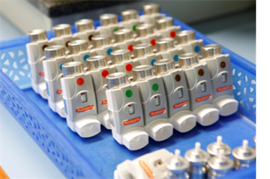
Evolving a successful product in the commercial phase
  What activities become important for a product after it is launched?
  There are many elements defining success at this stage:
  Maximised potential in all geographies
  Leveraging product understanding to reduce risk, scale volume and rationalise supply chain
  Life cycle management to maximise value
  Managed costs to maintain margin and respond to pricing pressures
The accumulated know how and experience at Vectura is fed back and applied to development products

Slide 19
Opportunities for enhanced product understanding, continuous improvement and growth post launch
Maximise
Minimise
Eliminate
Volumes and Capacity
Yields
Process capability
Efficiencies
Synergies/ economies of scale
Flexibility
Risk
Obscelesense
Cycle times
Downtime
Cost
Working capital
Redundancy
Waste
Excess inventory
Notes:
With the luxury of commercial batch trending of hundreds of batches, we have a large dataset on which to trend quality both of:
in-coming goods
finished product
Trending of release and commercial stability data allows process capability to be robustly measured, always aiming to minimize variability and for “middle of specification” performance, ideally, and if not, for the necessary interventions to be made.
We aim for robust process capability - to have a CpK > 1.0 for our critical quality attributes - and therefore to predict no batch failures
We have the opportunity to maximize, minimize and eliminate in all the areas listed in this side to ensure continuous improvement and growth

Slide 20
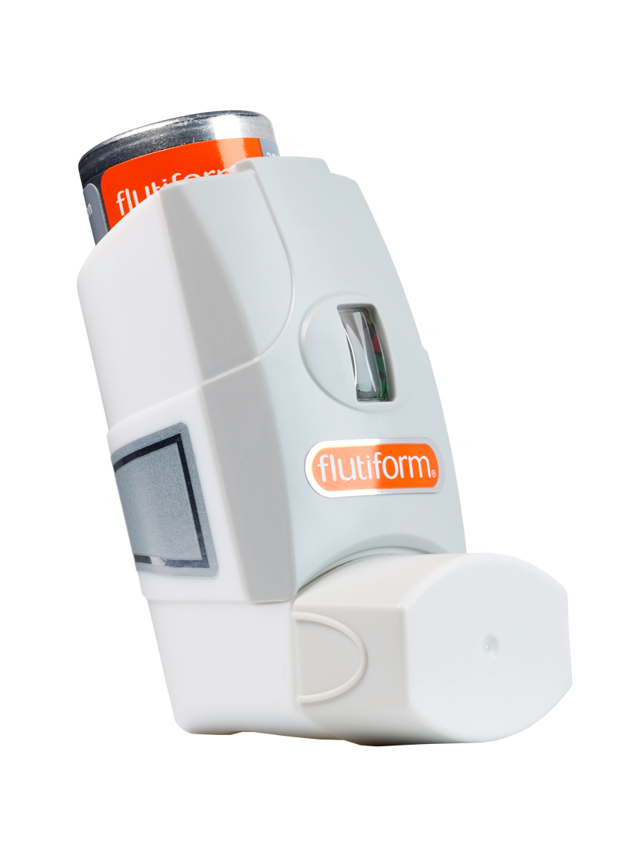
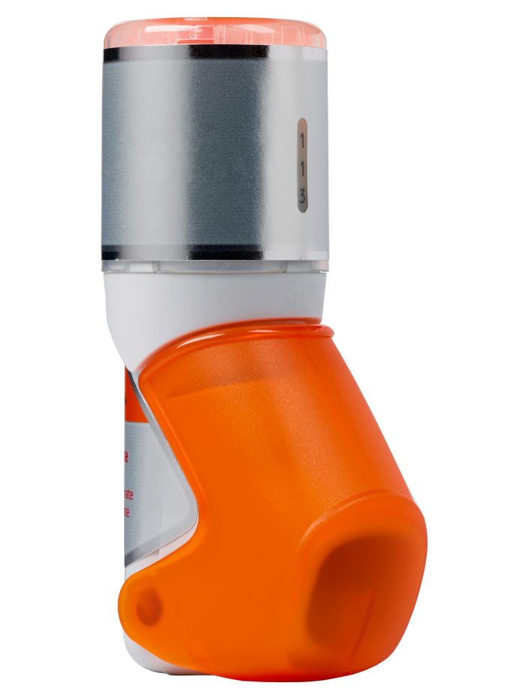
flutiform® success has continued post-launch through a number of key activities
flutiform® is an ICS/LABA pMDI
Available in EU, Japan and Rest of World for ~8 years
Vectura’s multi-disciplinary team of product stewards help maintain and grow flutiform® for our partner through:
  Capacity evolution
  Risk and change management
  Qualifying second supply sources
  Continuous improvements
  Lifecycle management – support development of breath-actuated K-haler®
  Commercial batch trending and review of process capability
  K-haler®
flutiform® is a registered trade mark of Jagotec AG (in some territories, owned by Mundipharma AG). K-haler® is a registered trade mark of Mundipharma.

Slide 21
Managing a global supply chain
Supplier Management
Supply Chain Management
Customer Management
Raw material usage & consumption
CMO planning monitoring
Capacity utilisation
Quality compliance
Raw material & component supplier management
KPIs
Customer demand management
Supply Planning
Long Term supply management
ERP system
Capacity monitoring
Management reporting
Process and KPI definition and implementation
Forecast & order process
Process compliance
Process improvement
KPIs
Logistics support/
coordination between CMO
and customers
New product launches support

Slide 22
From Feasibility to Final Product: Delivering Success for an Inhaled Development Programme
1
Consider key technical, disease and patient characteristics to inform technology platform choice
  Access to multiple formulation and device technologies offers flexibility based on the needs of your programme
Build scalability into your development programme early to reduce risk
  Making the right platform, process design and manufacturing equipment choices
  Innovate and improve post-launch with effective supply chain management
  Prioritise key post-launch improvement activities and focus on delivery and execution
2
3

Slide 23
Thank-you
For more information or to discuss your inhaled development programme, please contact us at enquiries@vectura.com

Slide 25
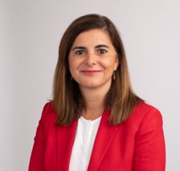

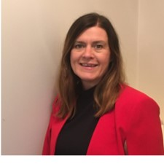
Meet the Speakers
Dr Geraldine Venthoye, Chief Scientific Officer & Executive Vice President – Product Development, Vectura
Geraldine Venthoye is a member of Vectura’s executive leadership team and a board director of its subsidiary companies in Switzerland. She leads the Pharmaceutical Development and Medical Device Development departments responsible for the strategic and technical advancement of the company’s products, development services and technology platforms.
Dr Sandy Munro, Senior Vice President – Pharmaceutical Development, Vectura
Sandy Munro is responsible for Vectura’s new technology development and also for product development programmes utilising Vectura’s smart nebuliser devices.
Sandy has been at Vectura since 2008 in a variety of pharmaceutical development leadership roles focused on dry powder inhaler (DPI) development programmes and technologies.
Nikki Willis, Vice President – Pharmaceutical Development, Vectura
Nikki Willis leads Vectura’s pharmaceutical development department, responsible for dry powder inhaler (DPI) product development programmes.
Nikki has worked in inhaled product development for over 30 years and joined Vectura in 2011, predominantly involved in the development of generic DPIs for the US market.

