Slide 1

Inhaled product development: fast-to-clinic approaches
View as Slide Show for Audio
Sandy Munro
SVP – Pharmaceutical Development

Slide 2

Key Topics
Selecting the right delivery platform technology for an inhaled programme
Key platform technology decisions during a programme
Case study: a cost-effective, fast-to-clinic development

Slide 3
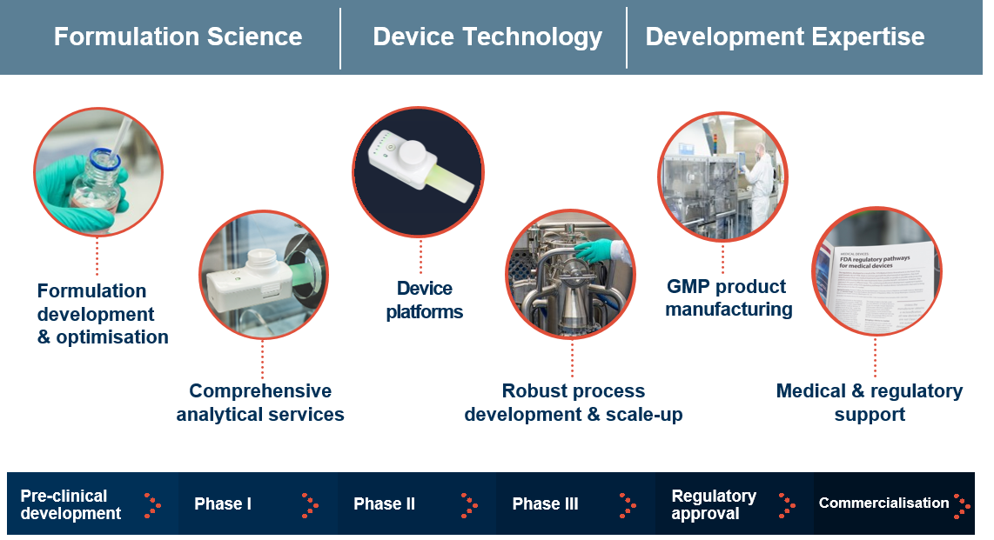
Vectura offers fully-integrated services to support customers in the development of inhaled medicines

Slide 4
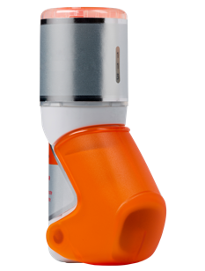
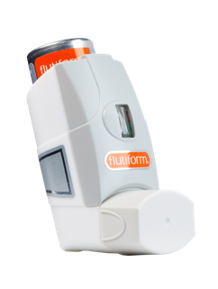
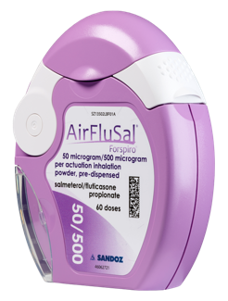
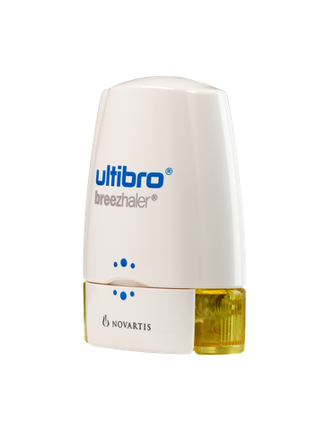
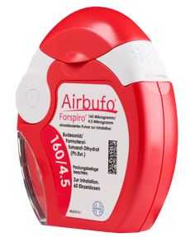
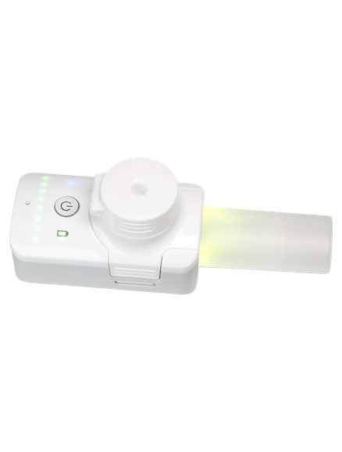
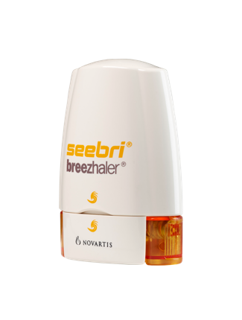
Helping our customers succeed in bringing inhaled medicines to market
Airbufo®, AirFluSal®, Forspiro®, Ulitbo®, Seebri® and Breezhaler® are registered trade marks of Novartis AG. flutiform® is a registered trade mark of Jagotec AG (in some territories, owned by Mundipharma AG). K-haler® is a registered trade mark of Mundipharma.

Slide 5
Selecting the right delivery platform technology

Slide 6
There is a lot of choice when it comes to inhaled delivery platforms…
Unit dose
Capsule
New propellant or old
Lactose blend
Dry powder inhalers
Pressurised metered dose inhalers
Blister
Multi-unit dose
Spray dried
Suspension or Solution
Breath actuated
Active DPI
Press & breathe
Smart or simple
Mesh nebuliser
Liquid spray inhalers
Flash vaporisation
Solution or suspension
Nebuliser devices
Exotica!
(unusual devices/
formulations)
Jet nebuliser
Unit or multidose

Slide 7
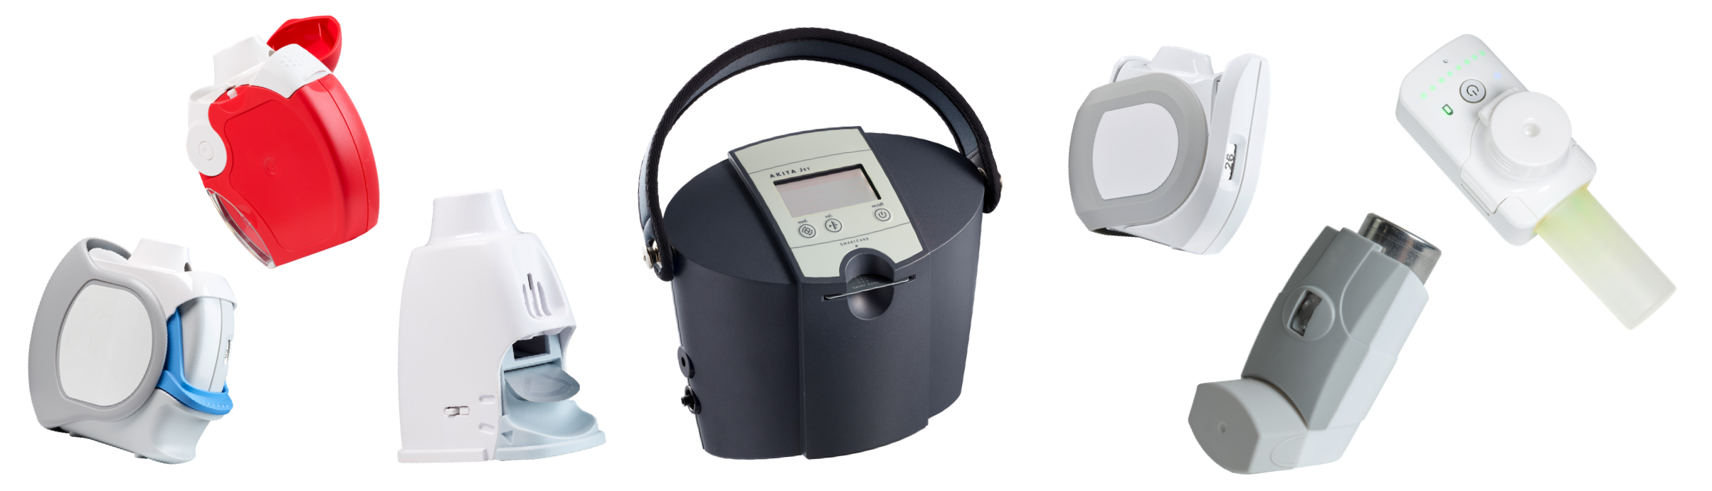
..how can we help our customers to navigate this complexity

Slide 8
Many factors influence delivery platform selection
Development Stage
Time & Cost
Technical
Commercial
Patient Characteristics
Disease State

Slide 9
What factors are typically most influential when it comes to platform selection?
Technical Considerations
  The molecule dictates what is possible – some options may be excluded quickly on technical considerations
  Speed and Cost
  Typical development programmes are very focussed on the next milestone & value inflection.
  Delivery platform doesn’t have to be representative of final commercial product – just “phase appropriate”
  Maximising Probability of Success
  Choosing a platform to give the asset the best possible chance of success
  Making use of connectivity in clinical trials or deep lung deposition from smart nebulisation

Slide 10
Key platform technology decisions during a programme

Slide 11
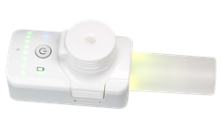
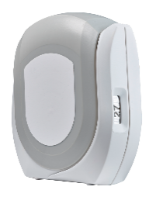
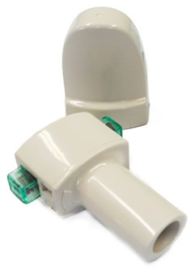
Not necessarily one platform choice for the duration of a programme - making informed choices can save time, money and reduce risk
Pre-clinical development
Phase I
Phase II
Phase III
Regulatory
approval
Commercialisation
Speed & cost
Target engagement & efficacy
Commercial-ready platform
Lifecycle management
Dosing flexibility & confidence of desired deposition
Scalability
Continuous improvement

Slide 12
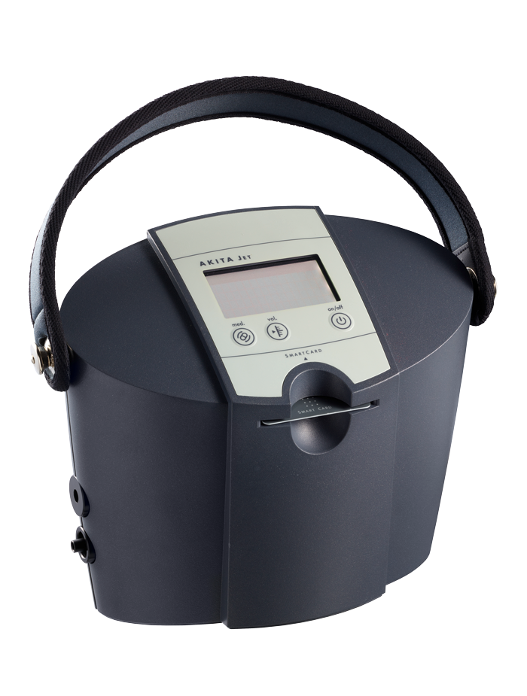
Typical approach for a fast-to-clinic development
Smart Nebuliser
High lung deposition including to the small airways
Able to accommodate very broad dose range (micrograms to 10s of milligrams)
FOX® VIBRATING MESH NEBULISER
Suitable for small molecules and biologics, formulated as solutions or nano-suspensions
AKITA® JET NEBULISER
Suitable for small molecules and some biologics, formulated as solutions or suspensions
Potential as multi-patient device in hospital setting
Capsule Dry Powder Inhaler
Suitable for lactose blends and spray-dried formulations
Moderate lung deposition
Flexible dosing (multiple fill weights and/or multiple capsules)

Slide 13
Case Study: Smart nebulisation for a cost effective, fast-to-clinic development

Slide 14
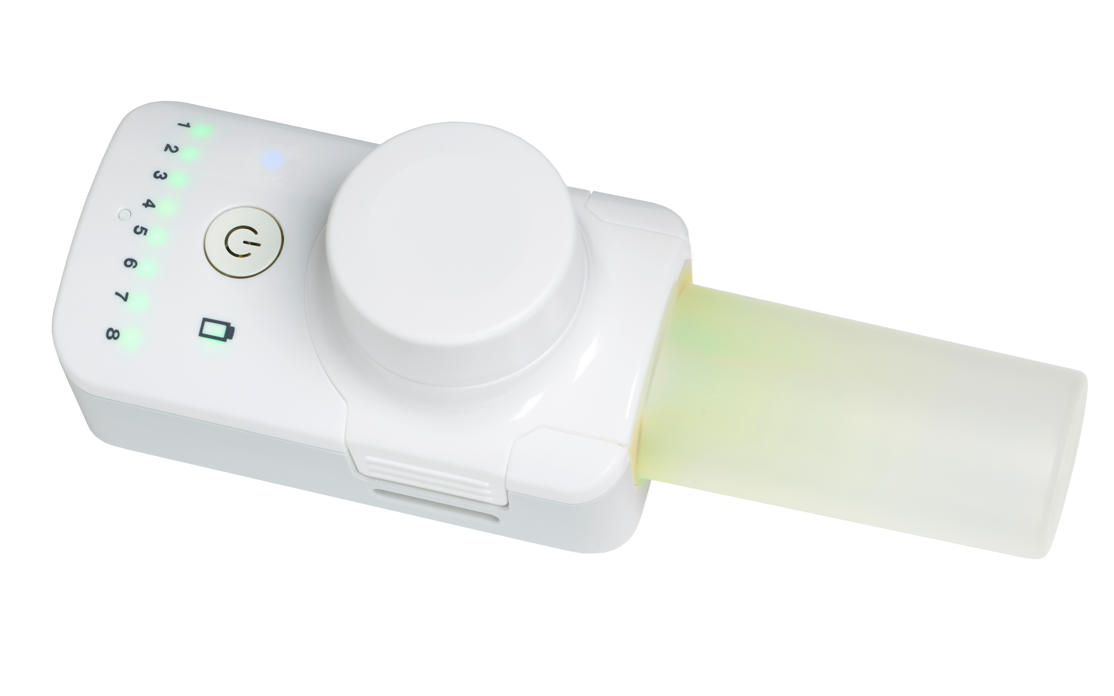
Small molecule development programme in a rare disease - How to accelerate to the clinic?
Key influencing factors
Early phase.
Speed to clinic important
High and deep lung deposition to maximise PoS
High Dose
Nebulised approach preferred
High water solubility
Minimise API consumption
At-home, ambulatory patient

Slide 15
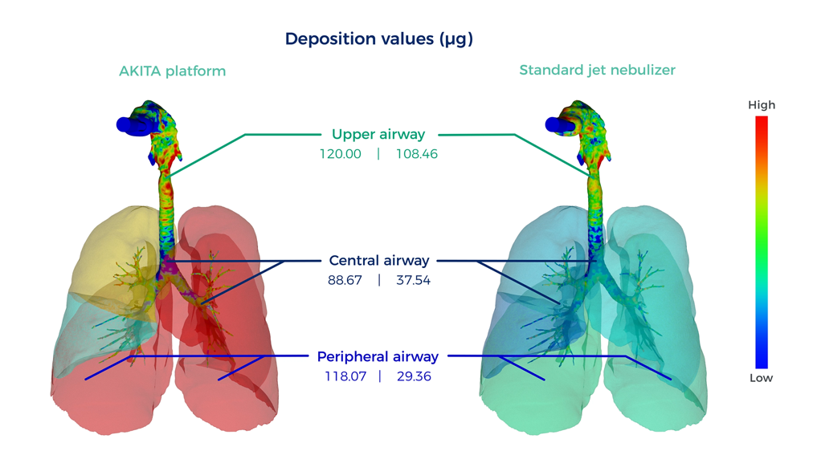
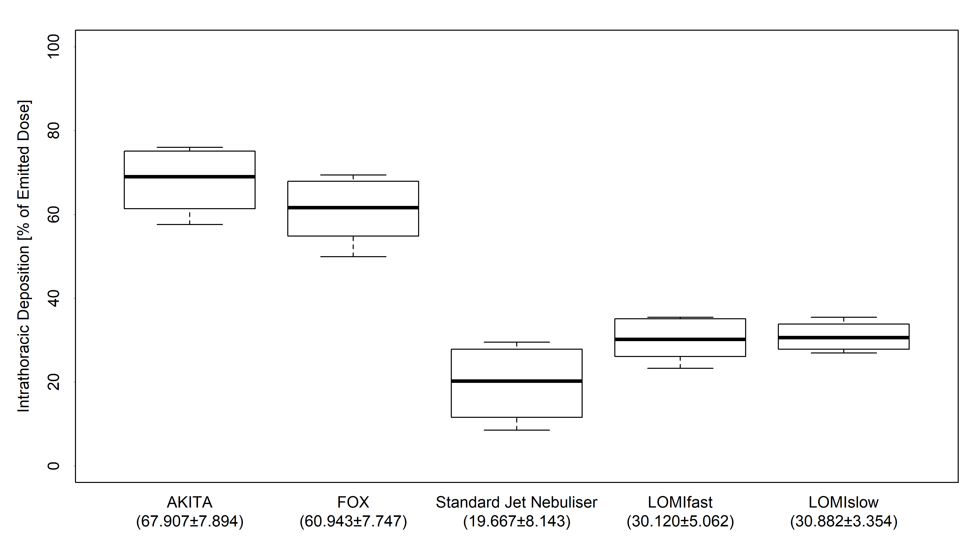
Advantages of Smart Nebulisation
AKITA® JET
CONVENTIONAL JET NEBULISER
High and deep lung deposition with AKITA® JET smart nebuliser
FOX® Advantages
Minimal formulation development
(soluble molecules)
Consistent delivery
Material sparing
Low device retention
High lung deposition with slow flowrate and synchronised release
Interaction between flow rate and particle size changes
Source: Vectura data on file
LOMI (Lever-Operated Multi-dose Inhaler is a Vectura proprietary dry powder inhaler)

Slide 16
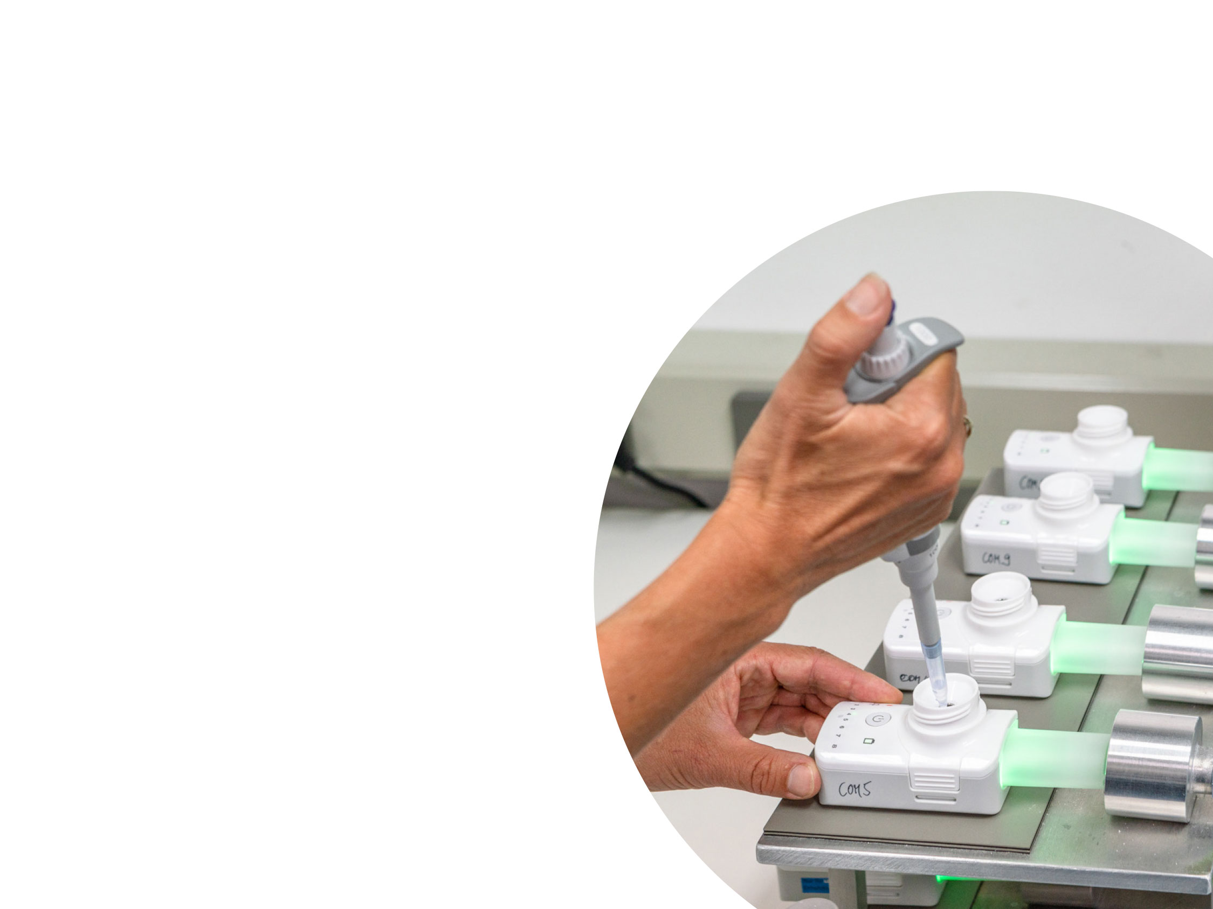
Smart nebulisation offers many advantages to accelerate and de-risk an early-stage development
  High lung deposition to maximise probability of success
  Less complex formulation development
  Consistent delivery
  API sparing
Notes:
)

Slide 17
Summary: fast-to-clinic approaches for inhaled development
1
There is bewildering amount of choice of inhaled delivery systems
  Choice of delivery platform is heavily influenced by molecule properties, speed & cost considerations and maximising probability of success
Device and formulation platform selection isn’t necessarily a once in a (product) lifetime decision
  Various points at which a change of platform might make sense
  Fast-to-clinic approaches with a specific delivery platform are ideal for many customers and applications
  Smart nebulisation or simple capsule DPI approaches can provide a fast and cost-effective route to clinic
  Vectura are device agnostic and can work with you to select the most appropriate system to meet your goals for the product
2
3

Slide 18
Thank-you
For any questions, more information or to discuss your inhaled development programme, please contact us at enquiries@vectura.com

Slide 19

Meet the Speaker
Dr Sandy Munro
Senior Vice President – Pharmaceutical Development
Sandy Munro is responsible for Vectura’s new technology development and also for product development programmes utilising Vectura’s smart nebuliser devices.
Sandy has been at Vectura since 2008 in a variety of pharmaceutical development leadership roles focused on dry powder inhaler (DPI) and nebuliser technologies.

